Slide 1
Language control framework
The language control system design methodology
stemmed from COSO framework
James Liao, Qiyu Liu, Bingying Liao
Gengyu Lin, Ting Yang

Slide 2
Agenda
01
02
03
Establish the control environment
Evaluate current situation
Control activities
Ensure the information quality
Monitor & Update
Introduction
Steps in framework
Feasibility

Slide 3
Introduction
Why stemmed from COSO framework?
The similarity between internal control and language control
 | Internal control | Language control system
Objectives : | Avoid financial fraud | Avoid problematic languages
Approaches : | Top down | Top down
Structures: | Company Wide | Company Wide
Methodology : | Could be similar!

Slide 4
Establish the
control environment
Step 1

Slide 5
Build up the cultural atmosphere and enhance the awareness would facilitate :
Educational events
Hand out brochures
Rules under articles
Use board of directors
Top – down approaches
Organizational structures
Everyone has awareness and positions.

Slide 6
Step 2
Evaluate current situation

Slide 7

Risks understanding
Establish a corporate-wide understanding of the risks of the problematic language
Improper usage of technological language may cause harm to a certain group of employees and may negatively affect work efficiency

Slide 8
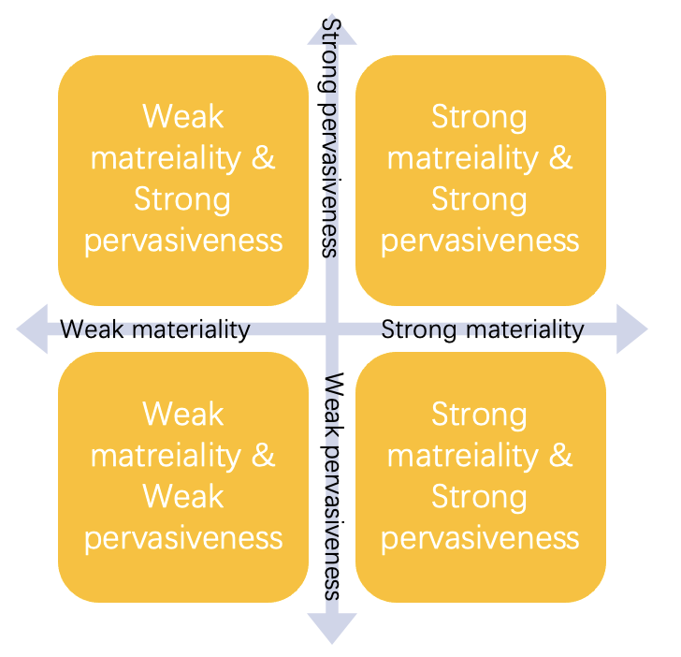
Risks classification
The risk should be classified according to the actual situation

Slide 9

Assessment and updation
Both the overall and subdivided risks require regular assessment
Set up the committee
Update the definition and rating of risk based on the results of the assessment

Slide 10
Control Activities
Step 3

Slide 11

Methodology
Develop specific problematic language control measures
Implement specific measures and monitor results accordingly
Improve measures based on feedback

Slide 12
Three parts of control activities: detective, corrective and preventive procedures.
Replace and report problematic languages
Corrective procedure
Detect and report existing problem languages
Prevent future problematic languages according to other procedures
Detective procedure
Preventive procedure

Slide 13
Step 4
Ensure the information quality

Slide 14

Information and communication are the key
Collaboration and awareness from everyone in the organization

Slide 15

Information requirements and communication channels
Identify information requirements
Define internal and external communication channels and protocols
Support the functioning of internal control

Slide 16

Procedures and education
Adjust current procedures or develop new procedures in a timely manner to respond to, manage, and communicate
Create handbooks to educate employees on the importance of using inclusive language
Avoid unconscious acts of discrimination

Slide 17

Ensure the information quality and efficient communication
The controls provided by the framework helps ensure that the communications occurring, internally and externally, are following best practices and working towards accomplishing the control of problematic language.

Slide 18
Monitor & Update
Step 5

Slide 19
Monitoring and update
Establish inclusive language committee
Supervise the implementation
Receive and evaluate feedback
Assist each department in joining the plan
Report deficiencies and solving plan
Set up monthly goal, quarterly goal, and yearly goal
Conduct separate costs, benefits, and evaluations

Slide 20
Feasibility Analysis

Slide 21





Advantages of using COSO framework:
Successful governance guidelines
Clear plan position
Improve current
internal control strategy
Better Costs savings & allocation
Careful structure for following up

Slide 22


Costs & Benefits of applying modified COSO framework:
Costs:
Benefits:
Education and promotion
Database and legacy system update
Detective tools
Extra salary for committee
Save the loss from employee leaving
Fair and trust working environment
Stronger team cohesion
Productivity increase
Positive corporate image

Slide 23
Summary

Slide 24
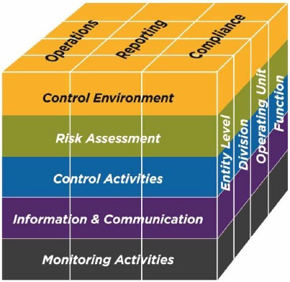
In this project, we suggest using a modified COSO framework to monitor the process of inclusive language:
Establish
Environment
Evaluate
Situation
Control
Ensure
Information
Monitor
We find that applying inclusive language detection through a framework comparable to COSO can establish a rigorous and comprehend language control system
Source: www.coso.org

Slide 25
References
Guide: Inclusive Language and Vocabulary for Startups and Tech
The Costly Business of Discrimination - Center for American Progress
Cost of Conflict in the Workplace | Pollack Peacebuilding
Do All Your Employees Speak The Same Language?
What is the COSO Framework? | Reciprocity
Five Components of the COSO Framework You Need to Know
COSO Framework’s 17 Principles of Effective Internal Control
5 Essential Steps to Embedding Inclusive Language in Your Company
How to Use & Promote Inclusive Language at Your Organization
The Effect on Creativity and Performance for inclusive language

Slide 26
Q&A

